Slide 1


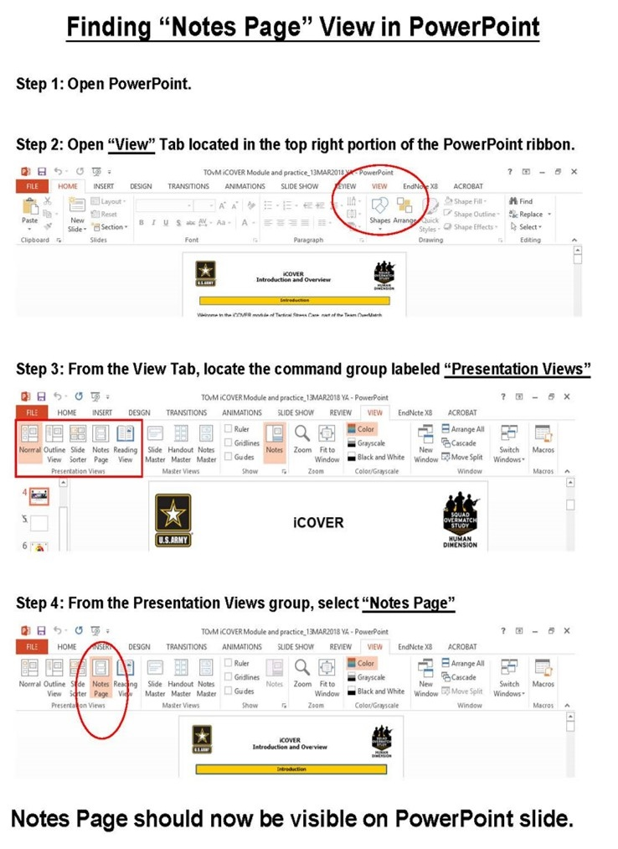
Facilitator Guide: Trainer notes
Notes:
Ask, Care, Escort
Annual Unit Suicide Prevention Training
Fighting Stigma Module
ACE Base +1
September 2023
VERSION 1.3
INSTRUCTOR GUIDE

Slide 2
(Hidden)
Notes:
i-A

Slide 3
(Hidden)
Notes:
i-B
Introduction
The Army Suicide Prevention Program was instituted by CSA General John A. Wickham in 1984. Since that time, suicide prevention and awareness has evolved. In 2009, Ask, Care, Escort (ACE) training was introduced to update existing suicide prevention training and to respond to a rise in suicide rates.
ACE training introduced suicide prevention and intervention concepts that had proven successful outside of the Army. Its primary goals were to increase suicide awareness and improve the ability of Soldiers to identify team members who may be suicidal and get them to help.
In 2018, ACE training was updated to highlight its use not only during a crisis, but also before one occurs by incorporating Army team building and unit cohesion concepts. This training is aligned with the Center for Disease Control and Prevention's strategic comprehensive public health approach to suicide prevention.
In 2022, the ACE suicide prevention and intervention material was updated yet again and coined ACE Base + 1. The training now consists of a base module along with a menu of “+1” modules that the unit’s command team can choose from based upon the unit’s needs. Together, the base module and the +1 module make up the mandatory one hour of annual suicide prevention and intervention training.
In addition to the tailored training approach, the training is now designed to be more interactive and conversational. In contrast to a traditional “annual briefing,” ACE Base +1 is an “annual conversation” at platoon level where Soldiers in the platoon are able to discuss how they can take care of one another on a human level as it pertains to suicide prevention and intervention.
In 2023, the Army’s suicide prevention and intervention training expanded to include a tailored curriculum for the Soldiers’ Circle of Support members and DA Civilians. A Soldier’s Circle of Support includes anyone whom the Soldier considers to be a priority within their support system, such as a spouse, significant other, parent, sibling, other family member, mentor, and friend. The intent is that offering Circle of Support members the same knowledge and skills while using the same language and strategies can enable conversation between the Circle of Support member(s) and the Soldier regarding suicide prevention and intervention. What’s more, it can promote effective communication, bolster protective factors like increased cohesion and connection, and increase suicide prevention efforts within the whole Army Family.
ACE Unit Training- Fighting Stigma Module

Slide 4
(Hidden)
Notes:
ii-A
ACE Unit Training- Fighting Stigma Module
Facilitated discussion and engagement: This training is designed to be facilitated by a single instructor and delivered in an interactive, discussion-based format (rather than conventional lecture or didactic format). Because this module utilizes group interaction, it is highly recommended that it be led by an instructor who is able and willing to elicit participant engagement through facilitating meaningful discussions and practical exercises. The practical exercises are essential in allowing participants the opportunity to try out the Ask, Care, Escort process strategies in a safe, non-threatening environment and develop competence and confidence to use the strategies in real-life scenarios.
Delivered in-person to small groups: The ACE training is intended to be delivered in-person and it is highly recommended that this training be conducted with small groups (fewer than 40). In-person training allows for optimal engagement and also fosters unit cohesion, thus building protective factors which is an aim of the training.
Cohesive efforts: It is strongly recommended that the ACE for Circle of Support training be offered around the same time frame that the Soldiers receive the ACE Unit Training. According to AR 600-63, ACE suicide prevention and intervention training must be offered to Circle of Support members on an annual basis. The ACE Active Listening for Circle of Support module resembles the content and format of the ACE Active Listening module for Soldiers but has been tailored for members of a Soldier’s Circle of Support (e.g., spouse, significant other, parent(s), siblings, extended family, friends, mentors).
Intent

Slide 5
(Hidden)
Notes:
ii-B
ACE Unit Training- Fighting Stigma Module
Note: Each module should be trained to standard and not to time, it is most effective when time is allowed for in-depth group discussion and participation. To maximize the benefits of this training, allow for extra time for dialogue and interaction.
Training Package Components: The complete “ACE Base +1” training package consists of five PowerPoint® presentations (i.e., ACE Base, Fighting the Stigma, Active Listening, Practicing ACE, Lethal Means) and a SmartGuide with key information to be discussed for each slide (see notes page iv for SmartGuide overview).
Training Precautions: The ACE suicide prevention and awareness training deals with sensitive information and may trigger painful memories or other issues for training participants. It is possible that someone attending the training may have experienced thoughts of suicide or may have experienced a loved one who has struggled with suicidal thoughts, ideation, or worse – died by suicide.
If you are not a chaplain or behavioral health provider, it is recommended that you have someone from the chaplain’s office or Behavioral Health Services on call during your training session. Be sure to coordinate before the training and obtain their name, title, and consent to act as an immediate resource if needed. Provide them with the date, time, and location of the training; on the day of the training, be sure to have the number(s) at which they can be reached or another plan for reaching them.
Training Requirements: The U.S. Army’s requirement for annual suicide prevention training is to complete one hour of training that includes the “ACE Base” module along with one of the “+1” modules.
The mention of any non-federal entity and/or its products is not to be construed or interpreted, in any manner, as federal endorsement of that non-federal entity or its products.

Slide 6
(Hidden)
Notes:
Training Preparation:
Content: This is the U.S. Army’s mandatory annual suicide prevention training (IAW AR 600-63). The material is based on the most current research and academic literature on suicide prevention and follows educational best practices. The training is designed to enable the instructor to successfully lead participants through suicide prevention concepts with interactive activities and discussions to prompt critical thinking. For the training to be most effective, it is advised that instructors review all content in advance.
When instructing, follow the content as written. Insert personal stories/examples as appropriate. Prompts are written into the SmartGuide to highlight times when personal stories/examples can be most valuable. There are many benefits of sharing a personal story or example. For instance, stories/examples can help a trainer to capture the audience’s attention, gain common ground with the audience, and engage the audience on a deeper level. Most importantly, effective use of personal stories or examples can help participants gain better contextual understanding of the material being taught.
The following guidelines can help ensure effective use of personal stories and examples. The story/example
serves a clear purpose, specifically it reinforces the training objective/content
helps participants to gain a better contextual understanding about the concepts
does not distract participants from the focus of training (e.g., be mindful of using potentially triggering or traumatizing examples/stories)
is simple, concise, and easy to follow/understand
Remember, sharing your personal stories/examples is to benefit the participant, not yourself. The story/example should highlight the content, not you as a person (e.g., avoid the mistake of making the training about yourself). Lastly, it is highly recommended that you practice your stories/examples before using them in a training session. Rehearsing the story/example can improve effective delivery, especially if the story/example is one that could be emotional for you to share.
Flow: This training module is comprised of four main sections.
iii-A
ACE Unit Training- Fighting Stigma Module

Slide 7
(Hidden)
Notes:
iii-B
Training Preparation (continued):
Language: Suicide can be an uncomfortable topic to discuss, and it can be difficult to find the words to talk about it. As researchers continue to learn more about suicide and those impacted by it, the language used continues to evolve. For example, the term “committed suicide” perpetuates the idea that suicide is a criminal act, which can be stigmatizing. Instead, consider the phrase “died by suicide” or “attempted suicide.”
Participants may unintentionally use stigmatizing language, as not everyone understands the harmful impact of these words. It is recommended that during the training, participants are allowed to use the words they feel comfortable with to promote open conversation; however, it is recommended that the instructor supports participant usage of destigmatized language and use those words themselves.
Important concepts: Although ACE Base +1 is an annual training requirement, the training does not have to be conducted or perceived as “just another mandatory briefing.” Instead, it is important that the trainer and participants see the ACE Base +1 modules as an opportunity for an annual discussion amongst Soldiers and leadership about the way the unit uses these skills and concepts in their day-to-day life and operations.
When Soldiers collectively implement the ACE process, use Active Listening, and are intentionally Fighting Stigma, it creates culture of trust and cohesion. Consequently, a culture of trust and cohesion encourages help-seeking behavior; Soldiers know that when they need someone, the Soldiers in the unit will have their back. As the trainer, work to present the material as a facilitated discussion so the Soldiers are learning the material but also learning from and about one another and actively building trust and cohesion.
ACE Unit Training- Fighting Stigma Module

Slide 8
(Hidden)
Notes:
iv-A
ACE Training Facilitation Strategies:
Review the SmartGuide prior to the training session. Take notes on when you may use different facilitation strategies to promote an effective learning experience for participants.
ACE Unit Training- Fighting Stigma Module

Slide 9
(Hidden)
Notes:
iv-B
ACE Unit Training- Fighting Stigma Module

Slide 10
(Hidden)
Notes:
v-A
ACE Unit Training- Fighting Stigma Module

Slide 11
(Hidden)
Notes:
v-B

Slide 12
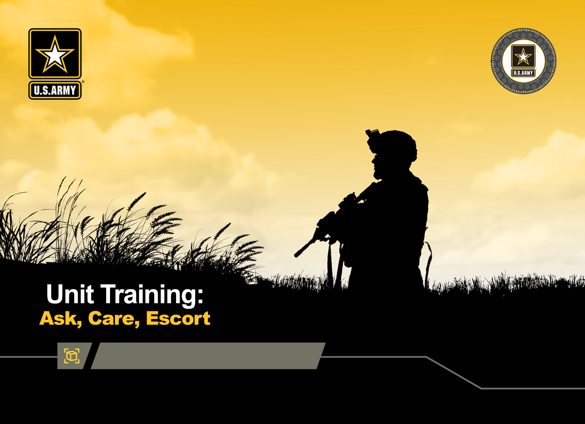



Fighting Stigma Module
DPRR
1
Notes:
Record your own notes here:
1-A
ACE Unit Training- Fighting Stigma Module

Slide 13
(Hidden)
Notes:
1-B

Slide 14




Concrete Experience
Many service members who have reported having suicidal thoughts or had a suicide attempt since joining the military have indicated that they did not talk to anyone or seek help.
What are some reasons that might contribute to Soldiers not reaching out or seeking help?
2
Notes:
2-A
ACE Unit Training- Fighting Stigma Module
[?]
Record your own notes here:

Slide 15
(Hidden)
Notes:
2-B
ACE Unit Training- Fighting Stigma Module
Record your own notes here:

Slide 16

Training Purpose
To enhance Soldiers’ ability to recognize and fight stigma and build unit cohesion to help prevent suicide within their unit
3
Notes:
3-A
ACE Unit Training- Fighting Stigma Module
Record your own notes here:
[NOTE: The Terminal Learning Objective (TLO) is as follows:
Action: Understand the primary elements of stigma and demonstrate ability to recognize and mitigate stigmatizing behavior
Condition: In a classroom environment, given training materials
Standard: Participants will, with 100% accuracy as assessed by the instructor
define and identify stigma and its primary elements
explain stigma’s impact on help seeking, unit climate of trust, and suicide prevention
identify the ways to end stigma and mitigate its effect on suicide prevention
There will be checks on learning throughout the training to ensure the objective and standards are being met.]

Slide 17
(Hidden)
Notes:
3-B

Slide 18

What is Stigma?
Stigma is the negative attitude toward people or ideas based on certain characteristics such as one’s mental or physical health or social attributes that might distinguish them from others in the group.
Public stigma
Self-stigma
Negative attitudes about certain behaviors or traits have been internalized; the person adopts a negative view of themselves
Negative or discriminatory attitudes others hold about certain behaviors or traits
4
Notes:
4-A
ACE Unit Training- Fighting Stigma Module
[?]
Record your own notes here:

Slide 19
(Hidden)
Notes:
4-B
ACE Unit Training- Fighting Stigma Module
Record your own notes here:

Slide 20

Impact of Stigma
How might the derogatory use of a slang term or label impact individual Soldiers and the unit as a whole?
Stigma undermines a unit’s culture of trust, which degrades unit cohesion and reduces operational effectiveness
Stigma is one of the main barriers for people getting the help and support they need when facing life challenges
Not seeking help early – or at all – can increase a Soldier’s risk for crisis, and subsequently contributes to a greater risk for suicidal thinking and behaviors
5
Notes:
5-A
ACE Unit Training- Fighting Stigma Module
[?]
Record your own notes here:

Slide 21
(Hidden)
Notes:
5-B
ACE Unit Training- Fighting Stigma Module
Record your own notes here:

Slide 22




Fighting Stigma
Soldiers reporting unit climates supportive of mental health are more likely to talk about their problems with fellow Soldiers and to seek help from behavioral health.
LEARN
How have you seen other people in the Army or society at large fight against stigma?
CHALLENGE
CONNECT
6
Notes:
6-A
ACE Unit Training- Fighting Stigma Module
[?]
Record your own notes here:

Slide 23
(Hidden)
Notes:
6-B
ACE Unit Training- Fighting Stigma Module
Record your own notes here:

Slide 24

Tactics to Fighting Stigma
LEARN - Be open to learn; take initiative to educate yourself about people and experiences different than your own to gain a deeper understanding.
LEARN
CHALLENGE
CONNECT – Be a reliable battle buddy, promote strong peer bonds and a sense of team unity, and demonstrate concern for each other.
CONNECT
CHALLENGE - Make on-the-spot corrections, challenge self-beliefs, and lead by example with your actions.
7
Notes:
7-A
ACE Unit Training- Fighting Stigma Module
Record your own notes here:

Slide 25
(Hidden)
Notes:
7-B
ACE Unit Training- Fighting Stigma Module
Record your own notes here:

Slide 26


Fighting Stigma: Practical Exercise 1
Part 1:
CPL Smith has been tasked with supervising a weapons cleaning detail outside the orderly room. There are members from all platoons in the company participating. While cleaning a weapon, he hears two Soldiers from 2nd PLT talking about SPC David and that he has been going to behavioral health and they can’t believe that he is even allowed to touch a weapon.
What should CPL Smith do?
8
Notes:
8-A
ACE Unit Training- Fighting Stigma Module
[?]
Record your own notes here:
[NOTE: Encourage small groups of 3-5 Soldiers as this size promotes a task-focus and optimal engagement from all members.]

Slide 27
(Hidden)
Notes:
8-B
ACE Unit Training- Fighting Stigma Module
Record your own notes here:

Slide 28
Fighting Stigma: Practical Exercise 2
Part 2:
After taking immediate action (challenge, learn/educate, connect), CPL Smith resumes cleaning a weapon when he notices that SPC David, one of the Soldiers from another platoon, has moved away from the group and is not participating in the way he was before the incident with the two Soldiers that CPL Smith corrected.
How can CPL Smith use the steps of ACE to check in on SPC David?
9
Notes:
9-A
ACE Unit Training- Fighting Stigma Module
[?]
Record your own notes here:

Slide 29
(Hidden)
Notes:
9-B
ACE Unit Training- Fighting Stigma Module
Record your own notes here:

Slide 30
Fighting Stigma: Practical Exercise 3
Part 3:
Later that afternoon, CPL Smith is asked by his PSG about the incident with the two Soldiers from 2nd PLT. CPL Smith then explains the stigmatizing language and the impact it had on SPC David. The PSG asks if the CPL has any suggestions on what they can do to help eliminate that type of behavior in their platoon.
What actions might CPL Smith
recommend to the PSG?
10
Notes:
10-A
ACE Unit Training- Fighting Stigma Module
[?]
Record your own notes here:

Slide 31
(Hidden)
Notes:
10-B
ACE Unit Training- Fighting Stigma Module
Record your own notes here:

Slide 32
Practical Application
What specific actions will you take to fight stigma inside the formation?
LEARN
Fighting unit stigma or public stigma often starts with taking a pause to look inward.
During challenging times, draw on the Army Values for motivation to engage in stigma-reducing behaviors and in the ACE process.
CHALLENGE
CONNECT
11
Notes:
11-A
ACE Unit Training- Fighting Stigma Module
[?]
Record your own notes here:

Slide 33
(Hidden)
Notes:
11-B
ACE Unit Training- Fighting Stigma Module
Record your own notes here:

Slide 34





Fighting Stigma and Suicide Prevention
Fighting stigma helps to lower the risk of suicide;
it shows you CARE!
Lower
Suicide Risk
Fight
Stigma
Improve
Trust
Improve
Unit Cohesion
Increase
Help-Seeking
12
Notes:
12-A
ACE Unit Training- Fighting Stigma Module
Record your own notes here:

Slide 35
(Hidden)
Notes:
12-B
ACE Unit Training- Fighting Stigma Module
Record your own notes here:

Slide 36
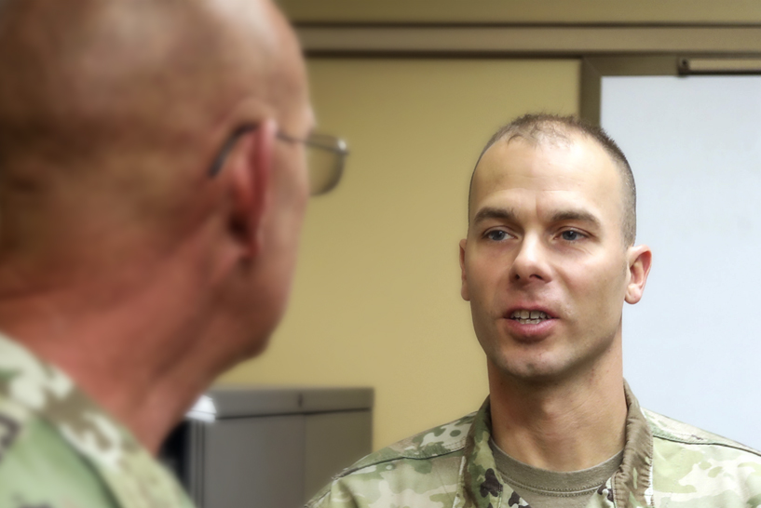
Next Steps: Plan to Implement
What is one thing you plan to do within the next week or two that can help lower the risk of suicide within your unit or among your friends and family members?
Preventing suicide requires taking proactive steps
13
Notes:
13-A
Record your own notes here:
ACE Unit Training- Fighting Stigma Module

Slide 37
(Hidden)
Notes:
13-B
Record your own notes here:
ACE Unit Training- Fighting Stigma Module

Slide 38

Fighting Stigma Makes a Difference
You are now armed with tactics to fight against stigma and aid the suicide prevention efforts of the unit.
Army policies are changing to be more supportive of Soldiers seeking help, but true change happens at the lowest level.
You are an integral part of the Army’s comprehensive and integrated approach to preventing suicide and protecting others from its devastating impacts.
14
Notes:
14-A
ACE Unit Training- Fighting Stigma Module
Record your own notes here:

Slide 39
(Hidden)
Notes:
14-B
Record your own notes here:
ACE Unit Training- Fighting Stigma Module

Slide 40
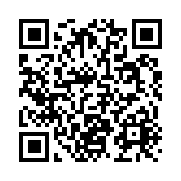
Post-Training Survey
https://wrair.gov1.qualtrics.com/jfe/form/SV_aXFrN0d3WYotIiy
Participants: You have just completed
the ACE Fighting Stigma module.
Completing the survey will assist the DPRR in determining the effectiveness of training and will inform curriculum revisions during the next update cycle.
If you received the Base module prior to this module, please select the
Base + Fighting Stigma option on the survey.
Notes:
Record your own notes here:
ACE Unit Training- Fighting Stigma Module

Slide 41
(Hidden)

Slide 42
(Hidden)
Notes:
15-A
References
Army Publications
Department of the Army. (2019). Army Leadership and the Profession (ADP 6-22).
https://armypubs.army.mil/epubs/DR_pubs/DR_a/ARN20039-ADP_6-22-001-WEB-0.pdf
Department of the Army. (2015). Army Team Building (ATP 6-22.6).
https://armypubs.army.mil/epubs/DR_pubs/DR_a/pdf/web/atp6_22x6%20FINAL.pdf
Department of the Army. (2016). A Leaders’ Guide to Soldier Health and Fitness (ATP 6-22.5). https://armypubs.army.mil/epubs/DR_pubs/DR_a/pdf/web/atp6_22x5.pdf
Department of the Army. (2015). Health Promotion, Risk Reduction, and Suicide Prevention (DA PAM 600-24). https://armypubs.army.mil/epubs/DR_pubs/DR_a/pdf/web/p600_24.pdf
Department of the Army. (2020). The Noncommissioned Officer Guide (TC 7-22.7).
https://armypubs.army.mil/epubs/DR_pubs/DR_a/pdf/web/ARN20340_TC%207- 22x7%20FINAL%20WEB.pdf
Other Publications
Arrabito, G R., & A.S. Leung. (2014). Combating the impact of stigma on physically injured and mentally ill Canadian Armed Forces (CAF) members. Canadian Military Journal, 14(2):25-35.
Retrieved November 10, 2022, from
http://www.journal.forces.gc.ca/vol14/no2/PDF/CMJ142Ep25.pdf
Ben-Zeev, D., Corrigan, P. W., Britt, T. W., & Langford, L. (2012). Stigma of mental illness and service use in the military. Journal of Mental Health, 21(3), 264–273. https://doi.org/10.3109/09638237.2011.621468
Britt, T. W., Wilson, C. A., Sawhney, G., & Black, K. J. (2020). Perceived unit climate of support for mental health as a predictor of stigma, beliefs about treatment, and help-seeking behaviors among military personnel. Psychological Services, 17(2), 141–150. https://doi.org/10.1037/ser0000362
Britt, T. W., Wright, K. M., & Moore, D. (2012). Leadership as a predictor of stigma and practical barriers toward receiving mental health treatment: a multilevel approach. Psychological Services, 9(1), 26–37. https://doi.org/10.1037/a0026412
Meisenbach, R.J. (2010). Stigma management communication: A theory and agenda for applied research on how individuals manage moments of stigmatized identity. Journal of Applied Communication Research 38(3):268-292. https://doi.org/10.1080/00909882.2010.490841
Office of the Chairman of the Joint Chiefs of Staff. (2014). Veteran Stereotypes: A Closer Look. Office of the Chairman of the Joint Chiefs of Staff. https://www.jcs.mil/Portals/36/Documents/CORe/141024_veteran_stereotypes.pdf
Smith, R.A. (2007). Language of the lost: An explication of stigma communication. Communication Theory, 17(4):462-485. https://doi.org/10.1111/j.1468-2885.2007.00307.x
ACE Unit Training- Fighting Stigma Module

Slide 43
(Hidden)
Notes:
15-B

